Slide 1
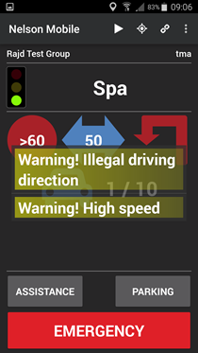
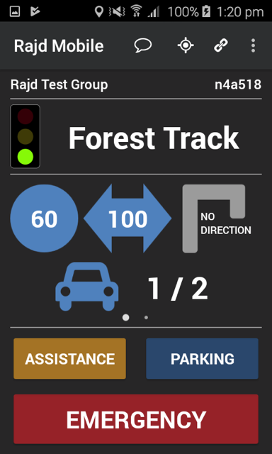
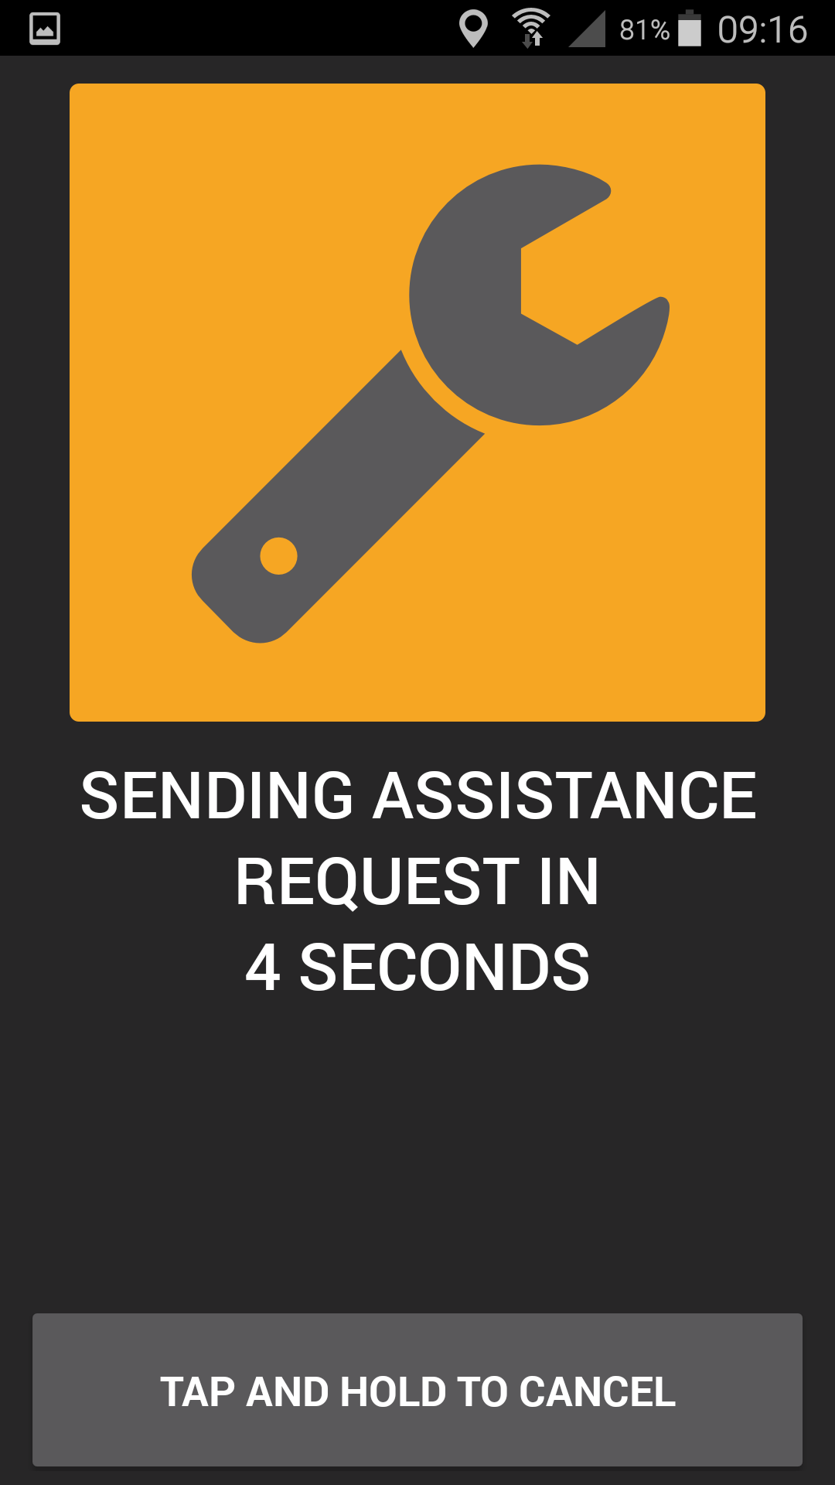
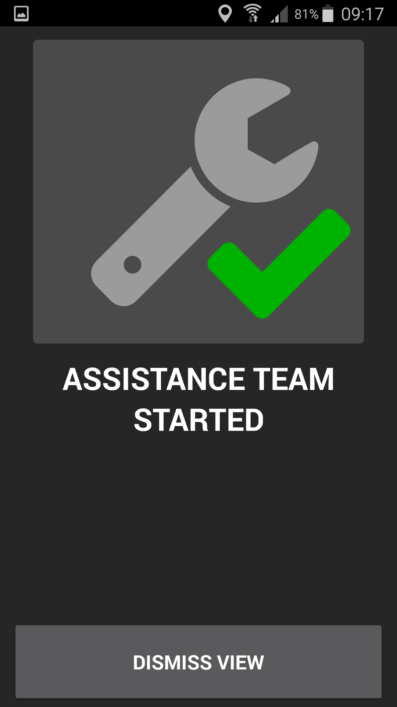
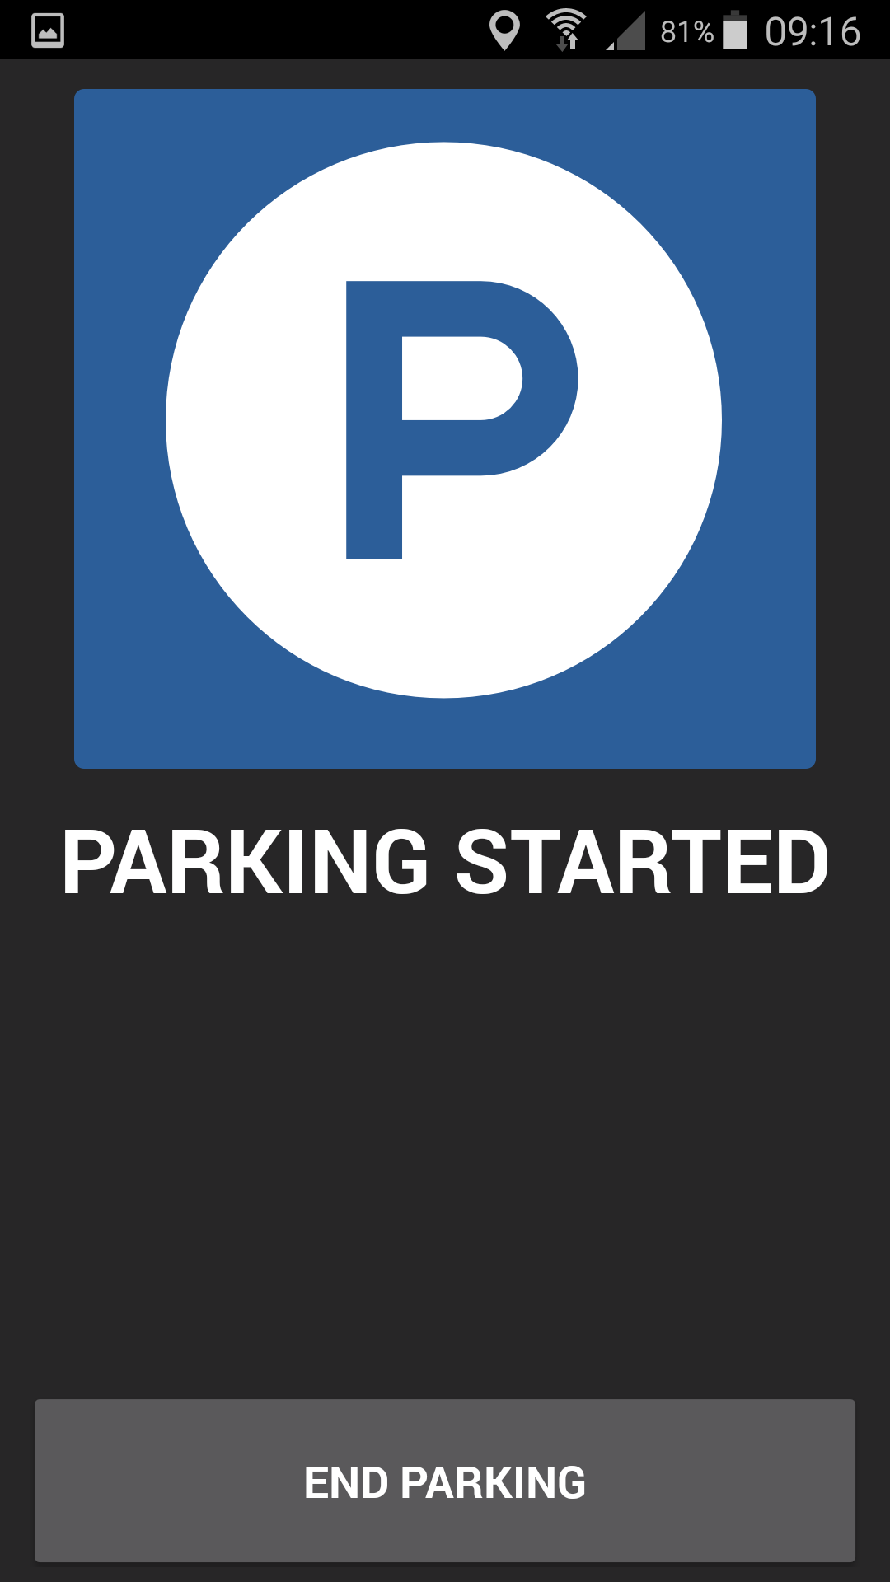
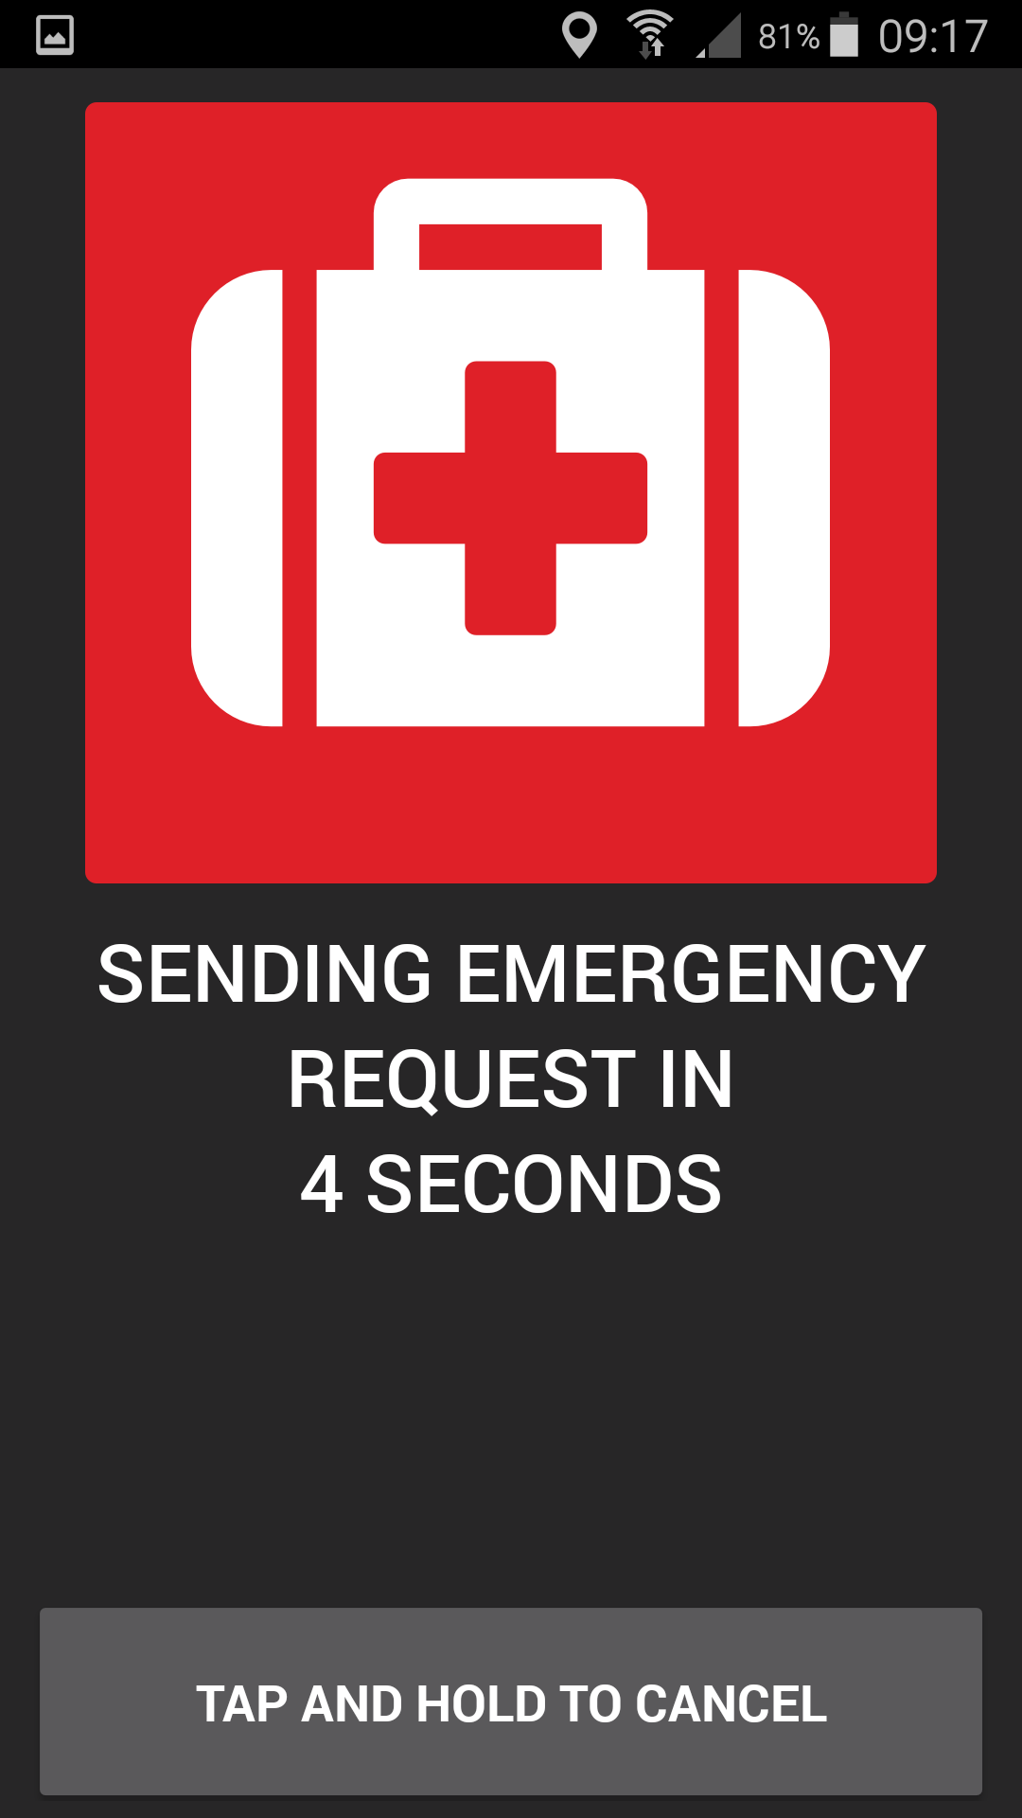
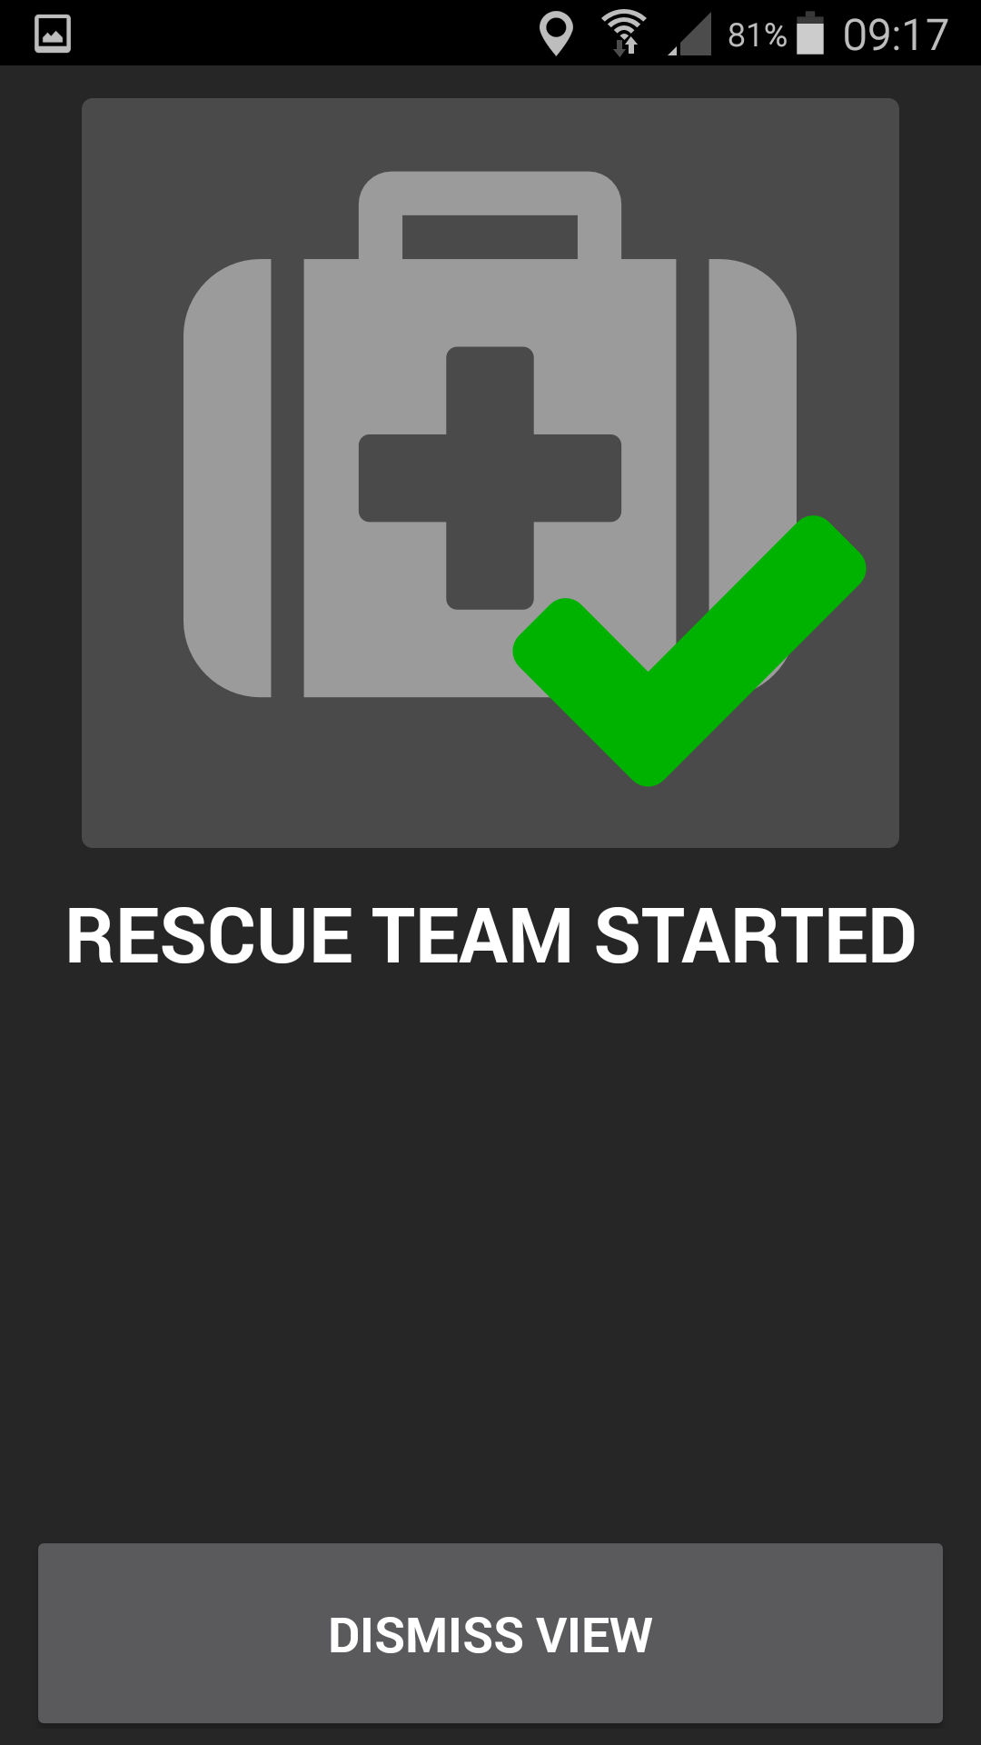
Messages
ajd Mobile
GPS
Forest Track
Connection
Menue
ajd Mobile
Name of Group
User/Driver Name
Status of Track
Name of Track
Speed Limit
Driving Direction
Min Distance
Nos of Vehicles vs allowed Nos of Vehicles
ASSISTANCE
PARKING
Button for Assistance
Button for Parking
EMERGENCY

